Slide 1
Updates on RestorationMapper

Slide 2
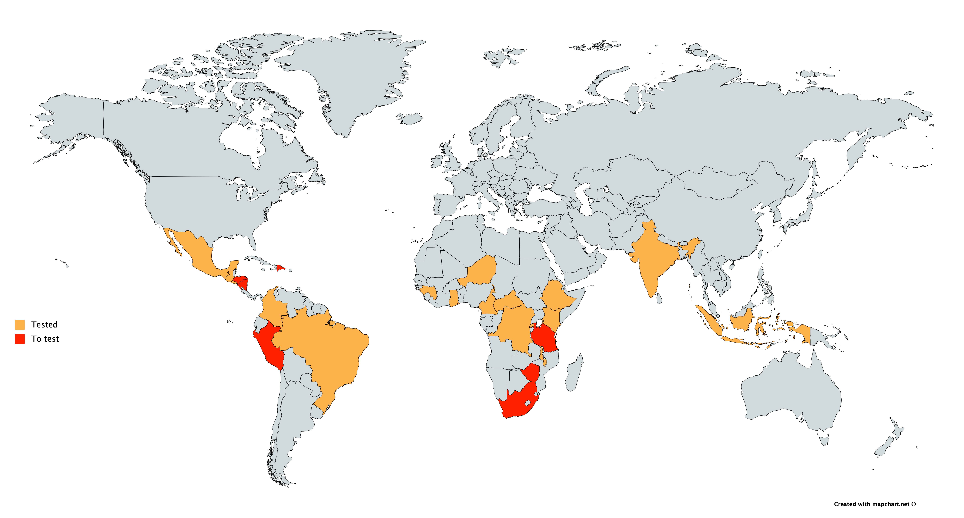
Tested Countries

Slide 3
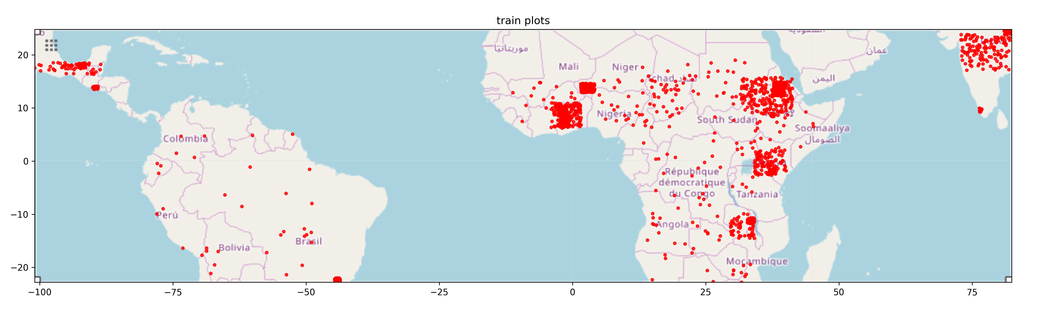
Source Data

Slide 4
Data and computational efficiency

Slide 5
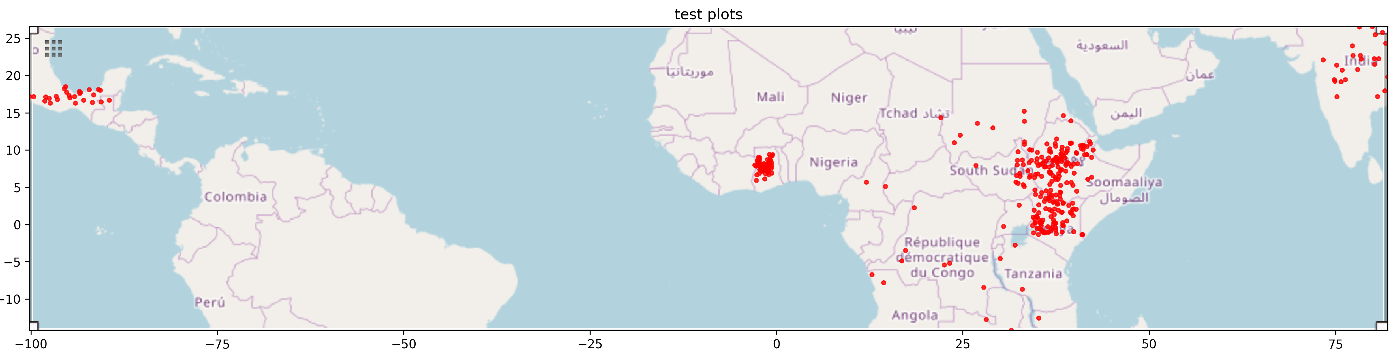
Accuracy
Overall: 79 -> 84.5%
Latin America: ?% -> 89%
East Africa: 79% -> 83%
West Africa: ?% -> 83%
India: ?% - > 78%

Slide 6
Next steps
Radar (sentinel 1)
Continent / region performance metrics
Parameter tuning
Cloud optimization
East Africa, West Africa, South America, LAC, India/Asia
~100 USD / 1 Million hectares

Slide 7
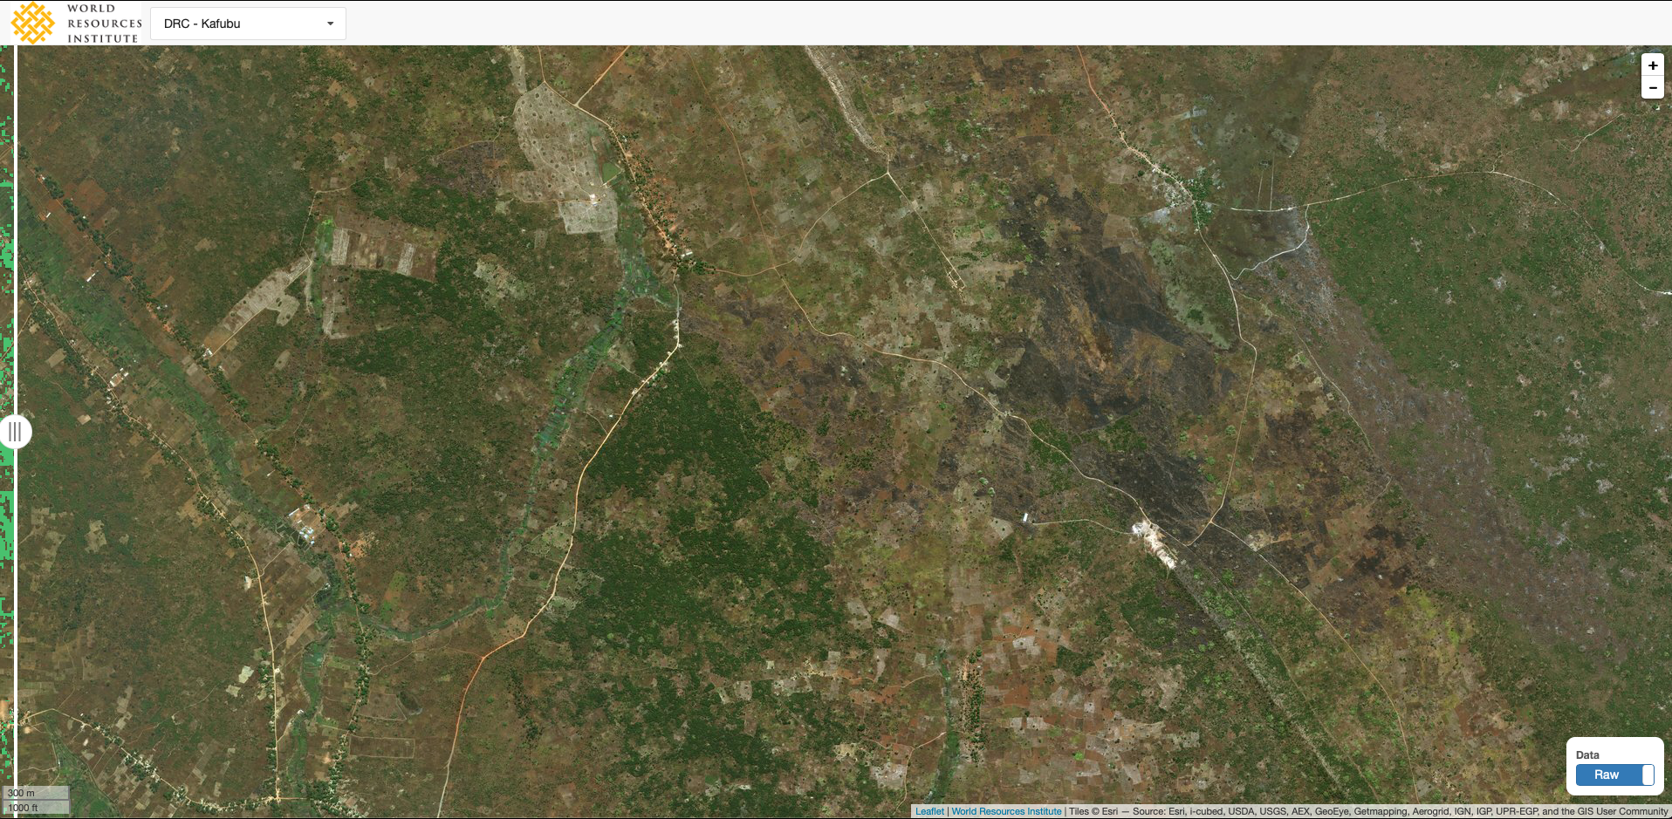
DRC

Slide 8
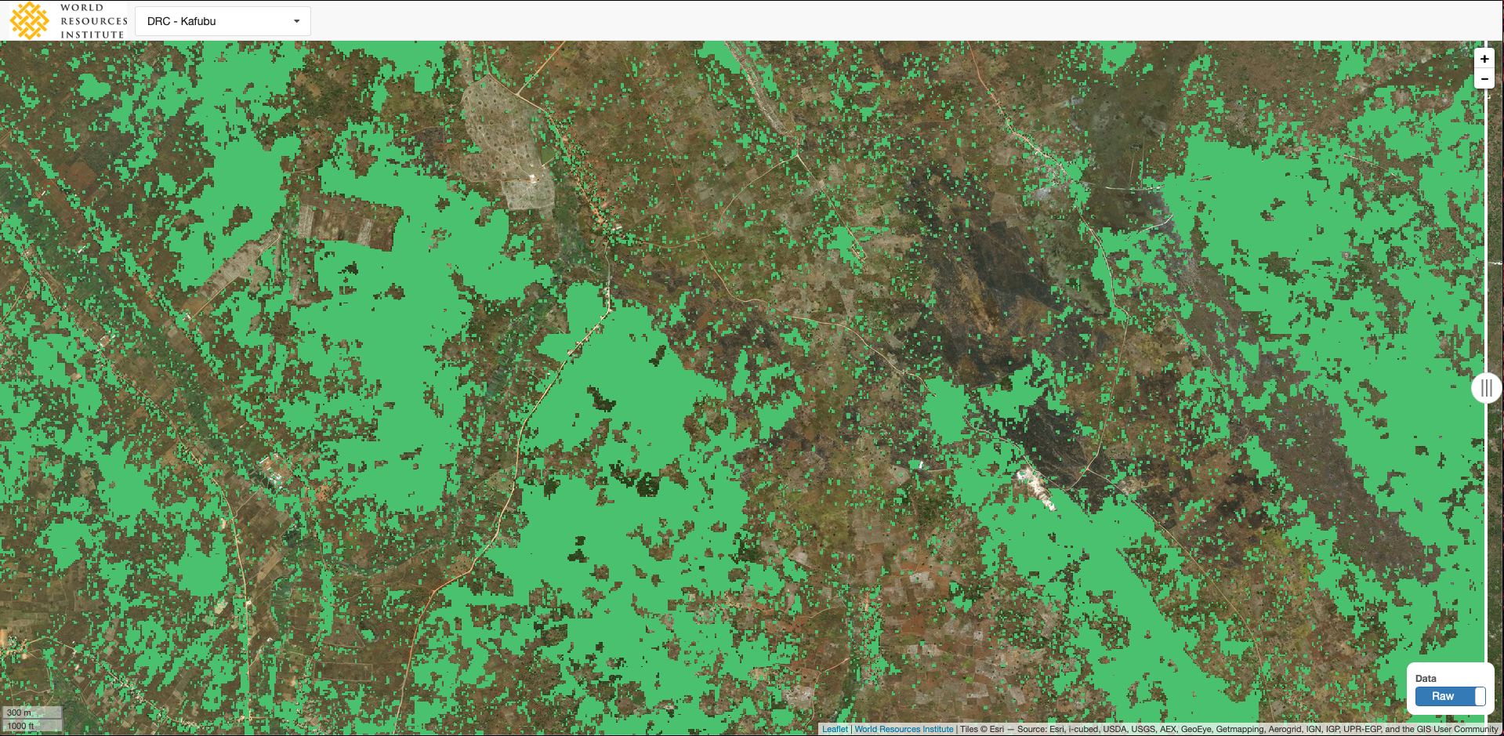

Slide 9
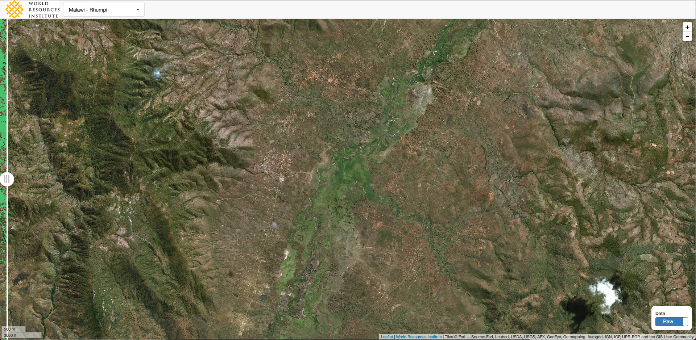
Malawi

Slide 10
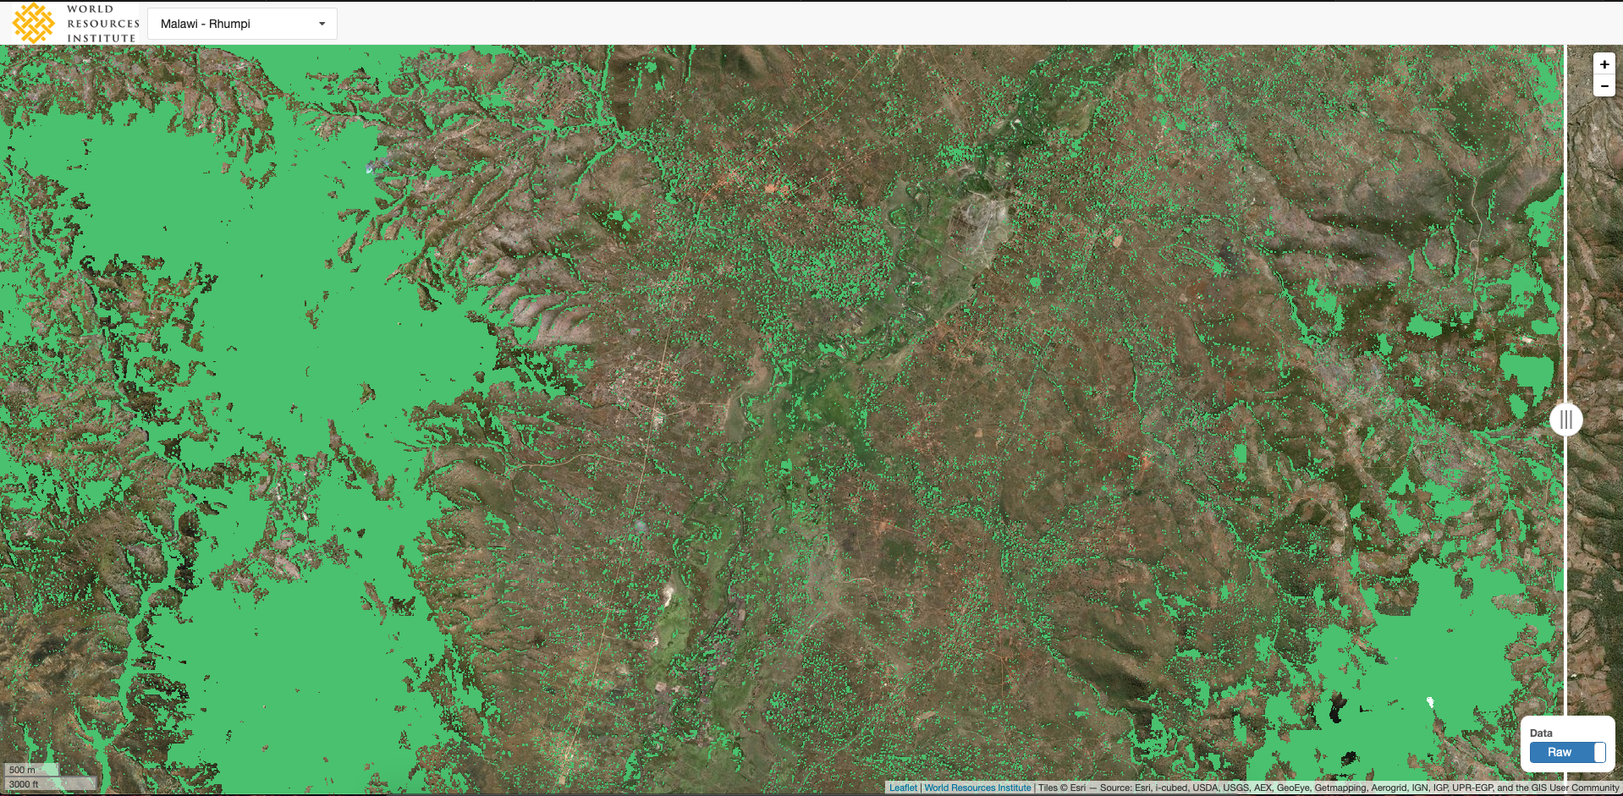
MALAWI

Slide 11
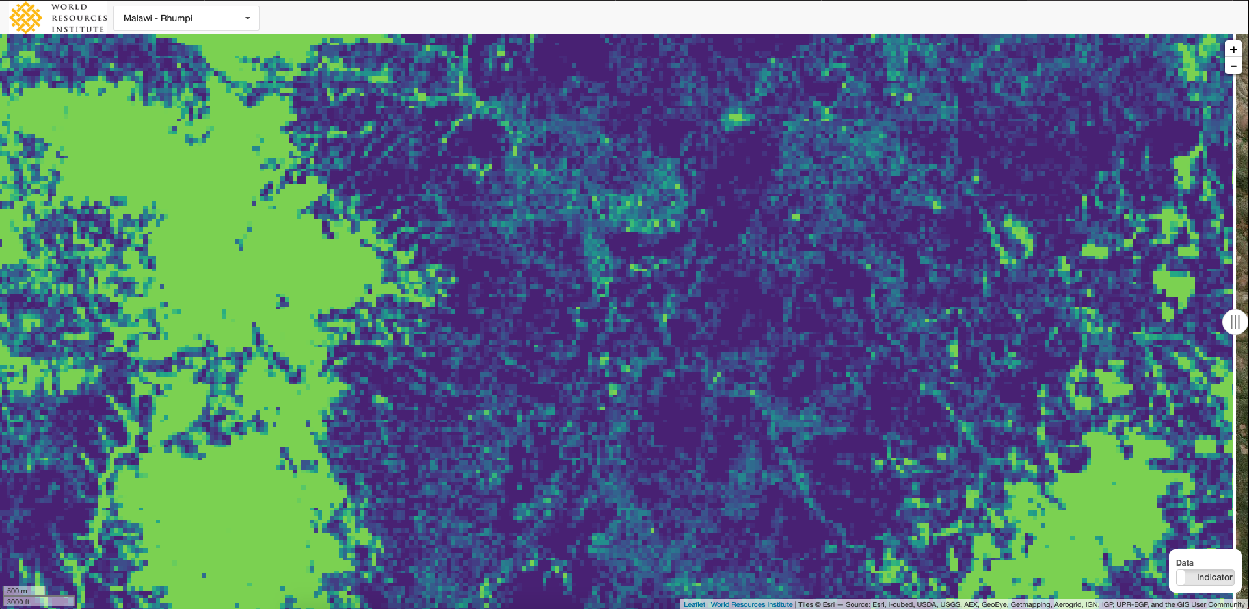
MALAWI

Slide 12
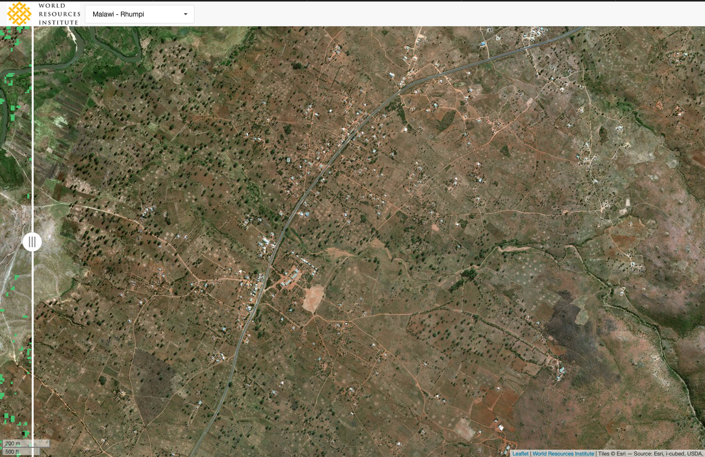
MALAWI

Slide 13
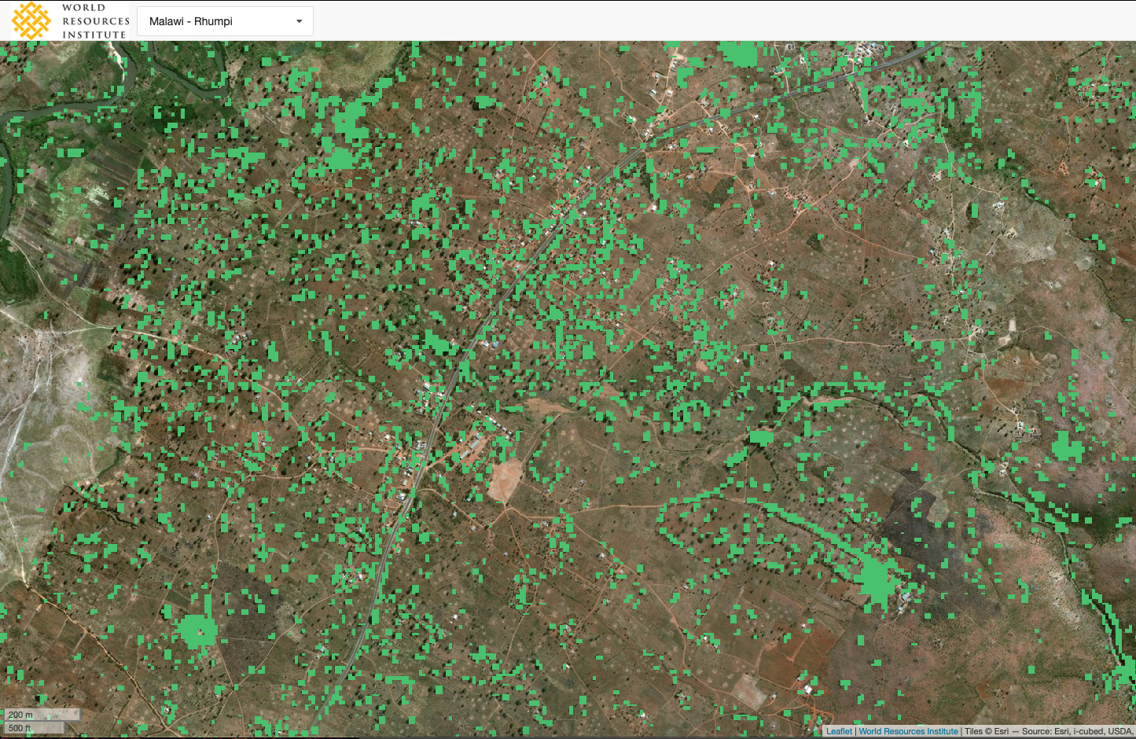
MALAWI

Slide 14
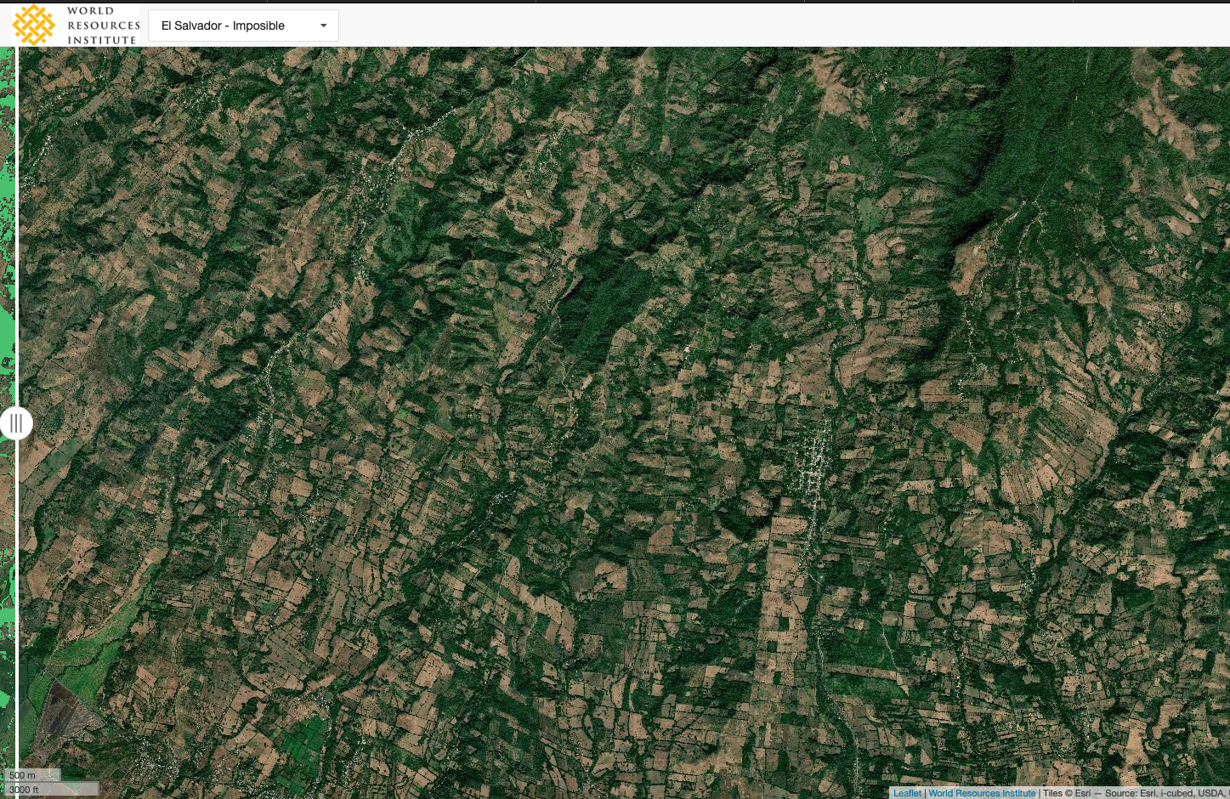
El SALVADOR

Slide 15
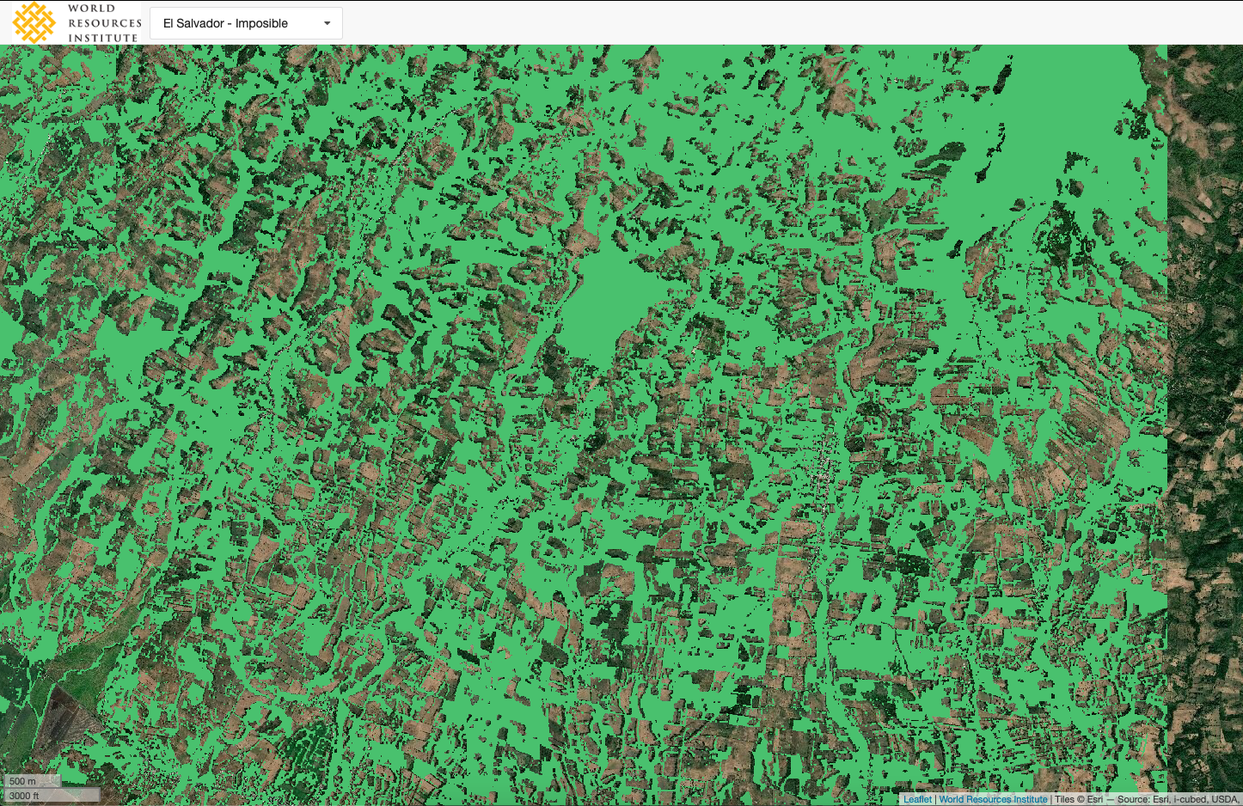
EL SALVADOR

Slide 16
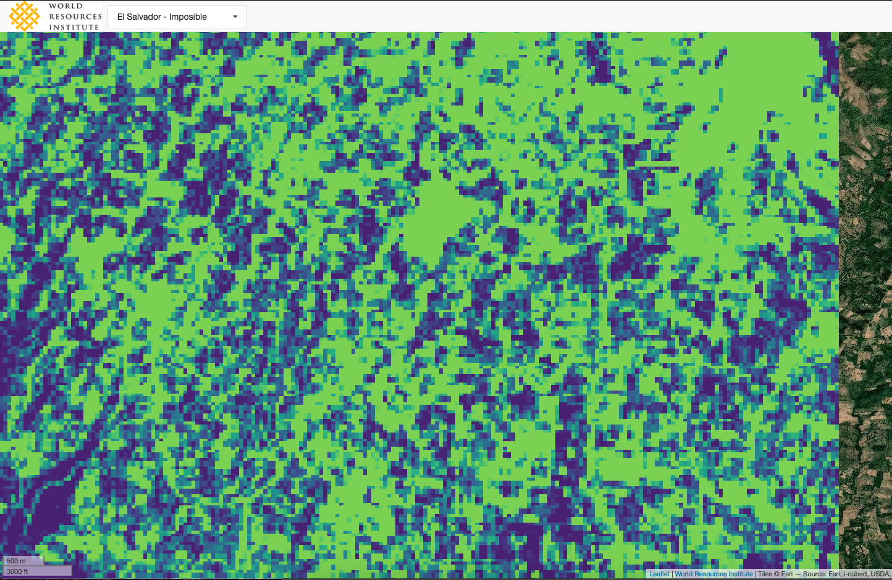
El SALVADOR

Slide 17
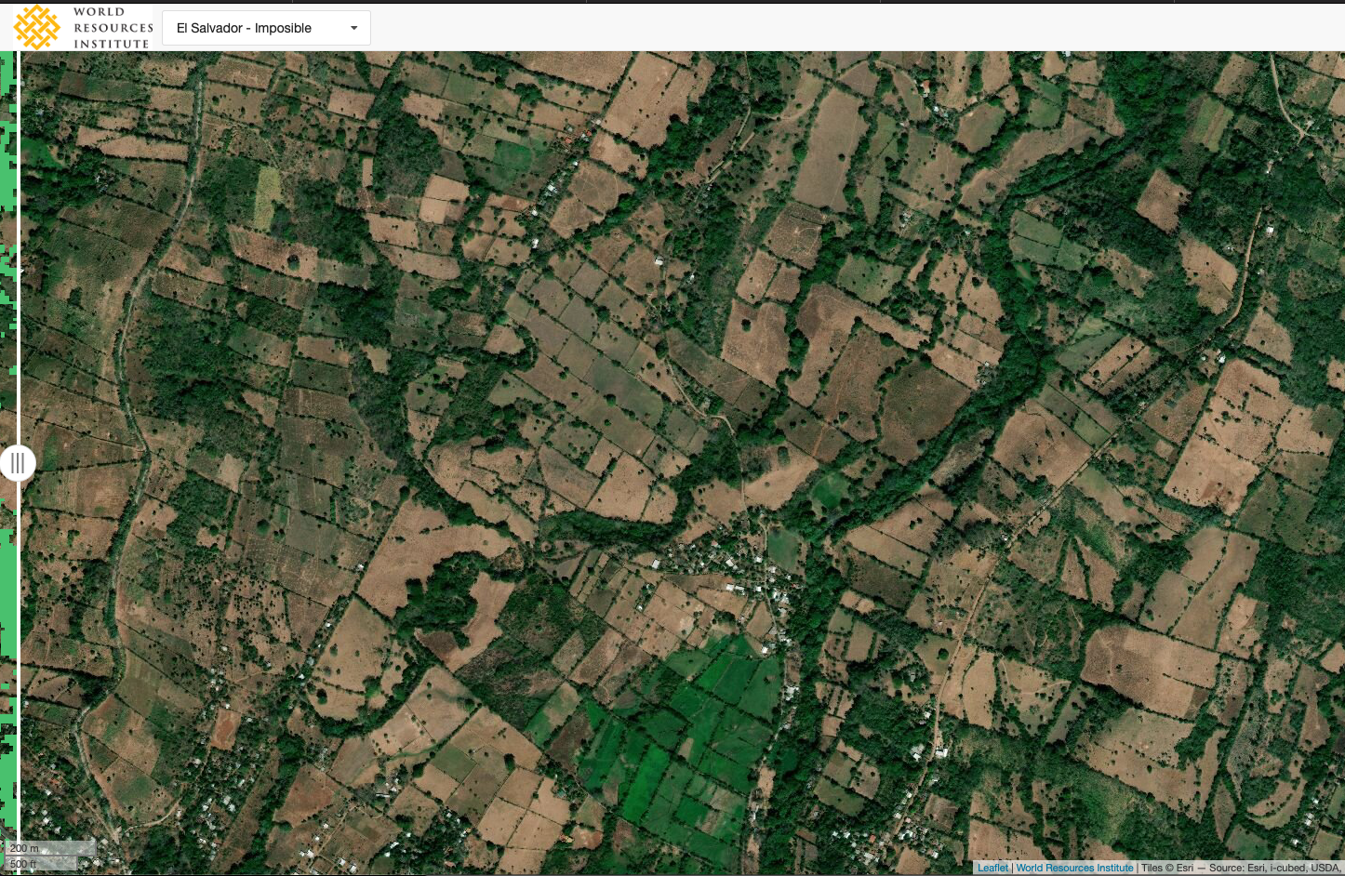
EL SALVADOR

Slide 18
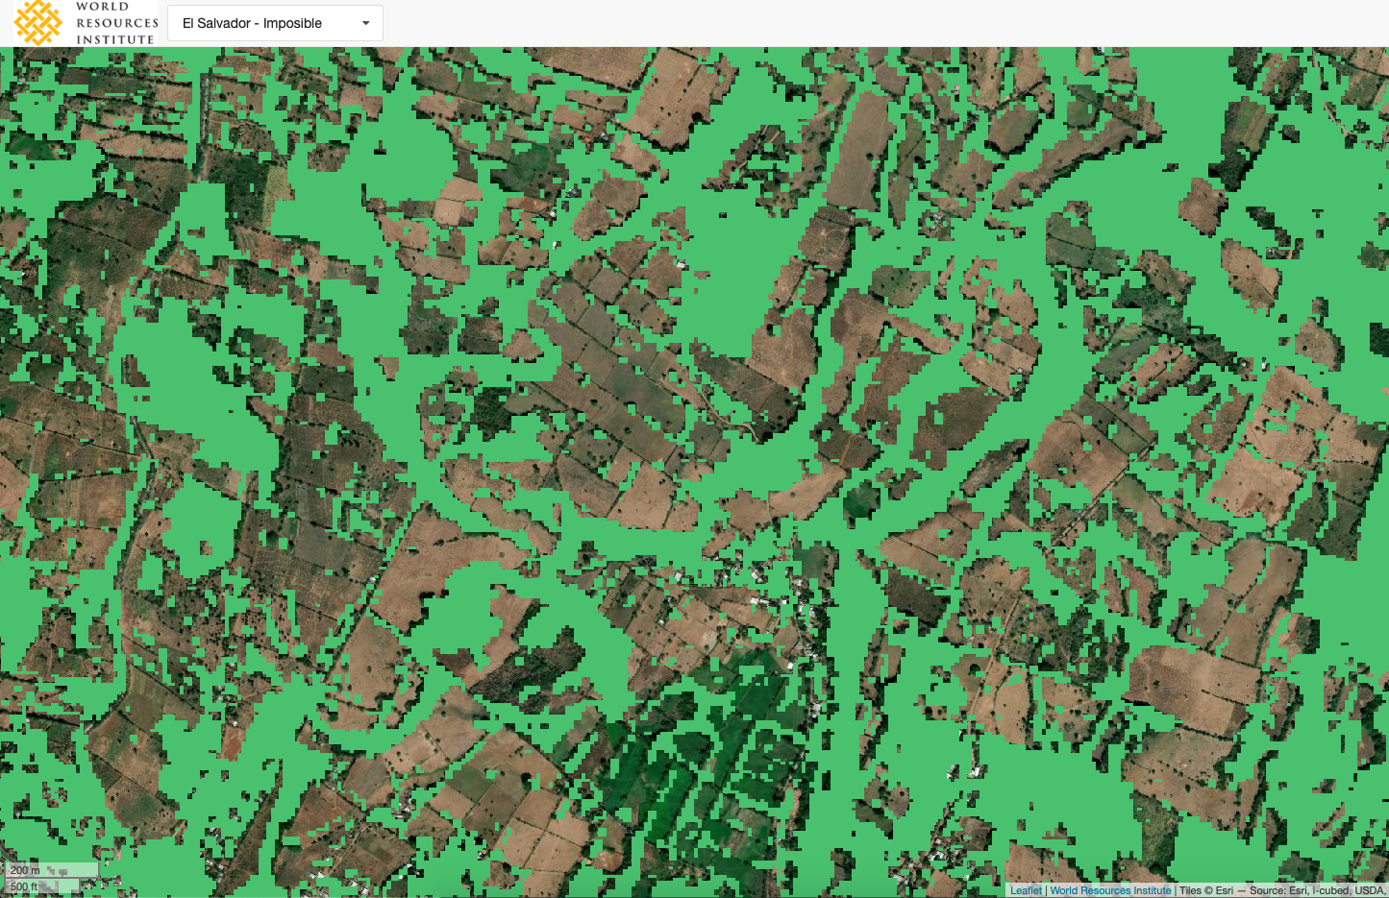
EL SALVADOR

